Slide 1


Xccelerate.co
Data Science - Power BI Part I

Slide 2


Introduction
Notes:
https://forms.gle/jnob3YLb33f7Zxcw5 - Feedback form

Slide 3
Power BI is a powerful business intelligence and data visualization tool developed by Microsoft. It allows users to connect, analyze, and visualize data from various sources, providing valuable insights and interactive reports. With its intuitive interface and drag-and-drop functionality, Power BI enables both technical and non-technical users to create compelling dashboards, charts, and reports that help businesses make data-driven decisions. Whether it's connecting to cloud services, on-premises databases, or Excel spreadsheets, Power BI empowers users to transform raw data into meaningful visualizations for better understanding and analysis.
Notes:
https://forms.gle/jnob3YLb33f7Zxcw5 - Feedback form

Slide 4
Where did it start?
Notes:
https://forms.gle/jnob3YLb33f7Zxcw5 - Feedback form

Slide 5
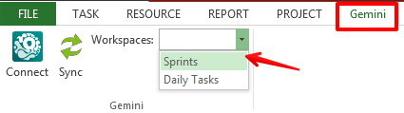
Project Gemini (2006-2010): The journey of Power BI began with Project Gemini, an internal Microsoft project aimed at enhancing Excel's data analysis capabilities. It focused on in-memory analytics and self-service business intelligence
Notes:
https://forms.gle/jnob3YLb33f7Zxcw5 - Feedback form

Slide 6
For the subsequent years, Microsoft kept adding features to Excel’s Gemini project.
Power Pivot (2010): In 2010, Microsoft introduced Power Pivot as an add-in for Excel 2010. It enabled users to work with large datasets, create data models, and perform data analysis using the Data Analysis Expressions (DAX) language.
Power View and Power Map (2012): With the release of Excel 2013, Microsoft added Power View for interactive data visualization and Power Map for geospatial data visualization, further enhancing the self-service BI capabilities of Excel.
Notes:
https://forms.gle/jnob3YLb33f7Zxcw5 - Feedback form

Slide 7

And then finally in 2015, Power BI was born.
Notes:
https://forms.gle/jnob3YLb33f7Zxcw5 - Feedback form

Slide 8
Download and Install Power BI
Notes:
https://forms.gle/jnob3YLb33f7Zxcw5 - Feedback form

Slide 9
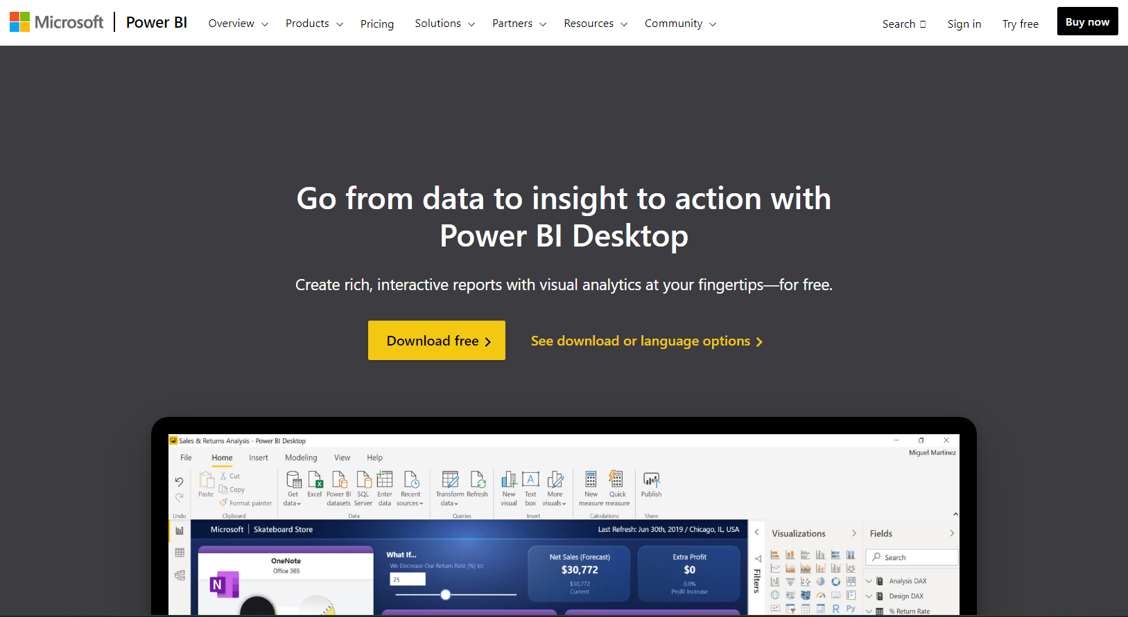
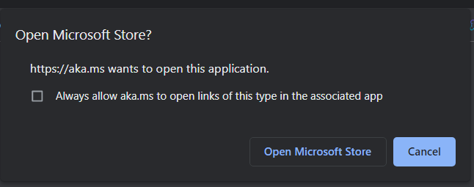
Power BI Link: https://powerbi.microsoft.com/en-us/desktop/
1
2

Slide 10
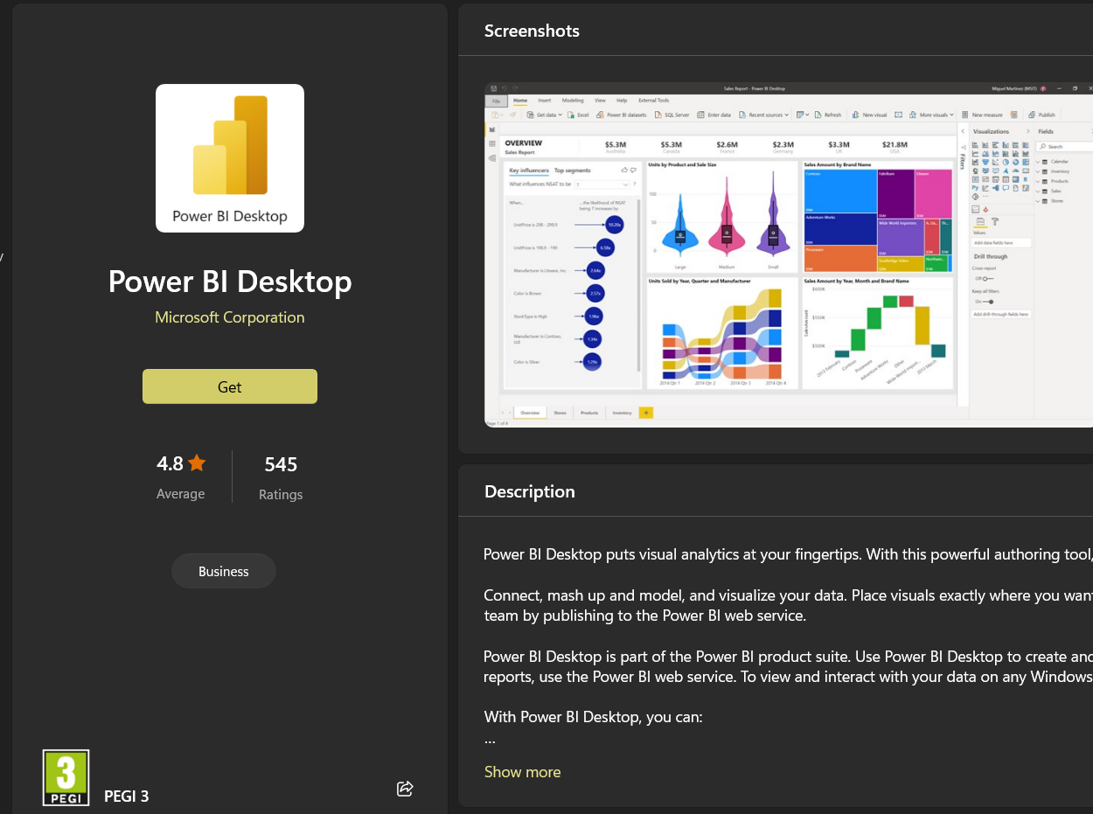
3

Slide 11
OR

Slide 12
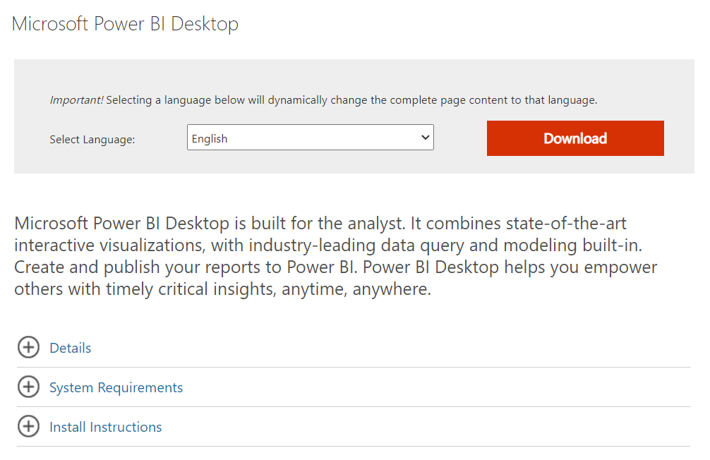
1
2

Slide 13
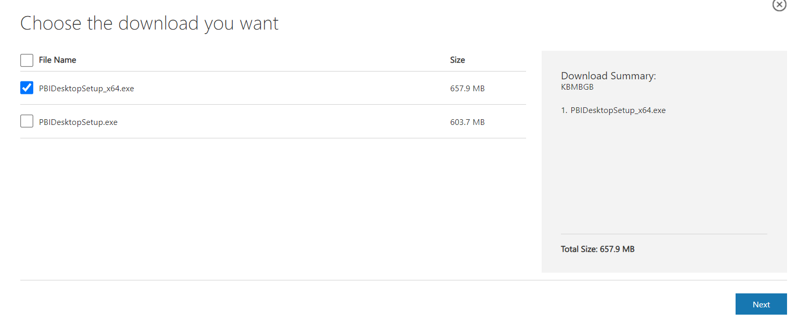
3
4

Slide 14
Interface Walkthrough

Slide 15
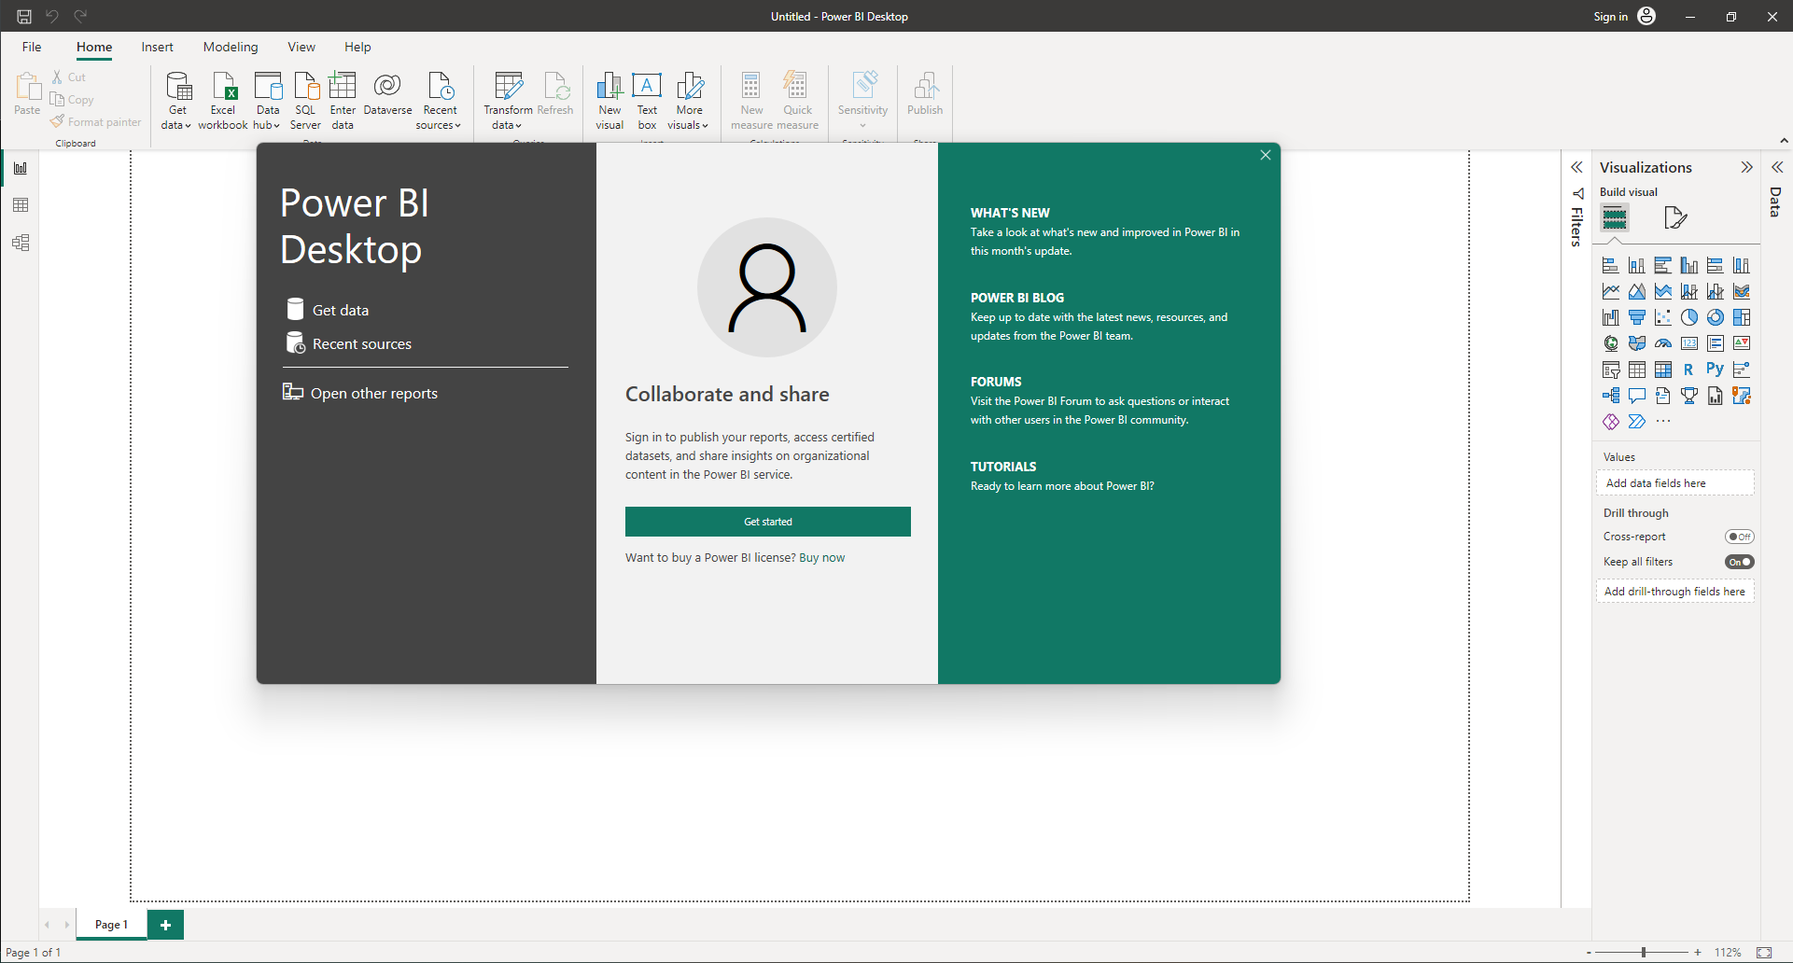
Top Ribbon: Data handling
Side panel: Table and relationship viewer
Close the pop-up
Side panel: Visualisation tools and filters
Main Area
Pages tabs

Slide 16
Let’s Load Some Data

Slide 17
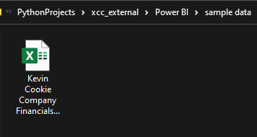
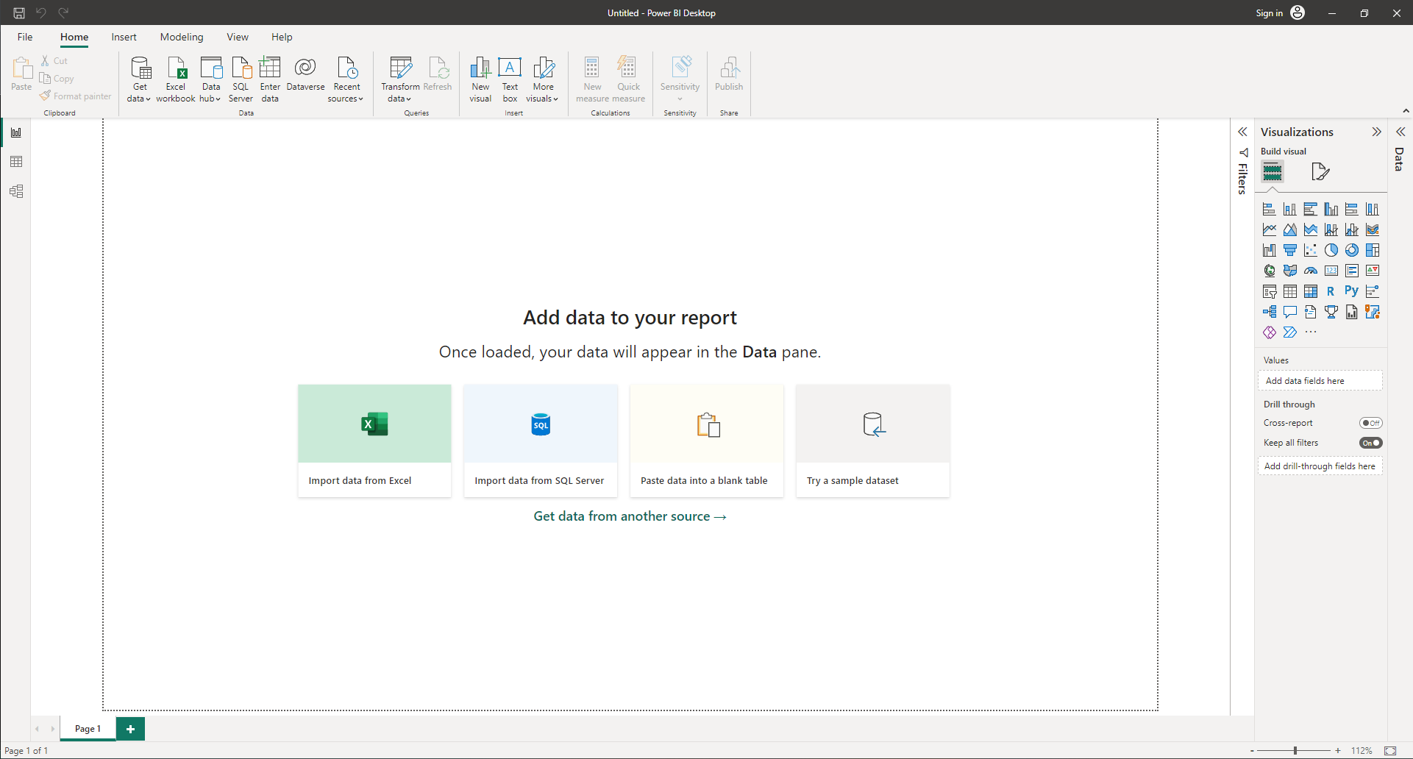
1
Locate your data
2
Click Excel Workbook

Slide 18
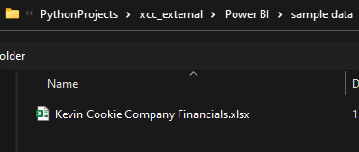
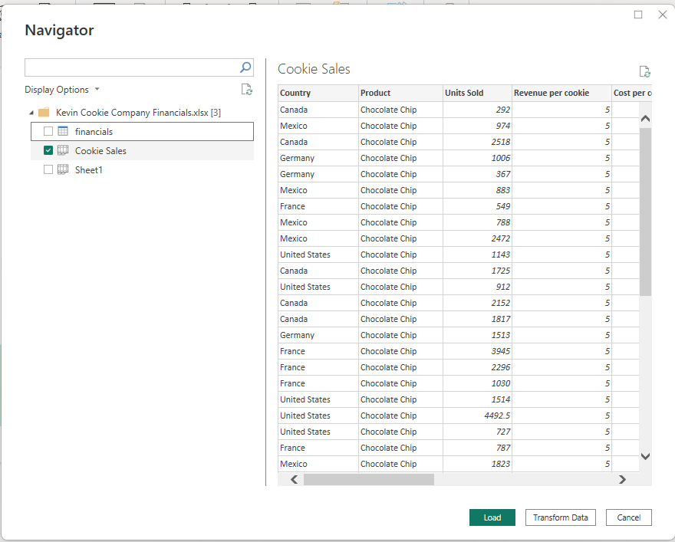
3
Browse to the same location and select the excel file
5
4
Select one from financials or Cookie Sales. Both are same.
Preview your data here
When ready press Load
6

Slide 19
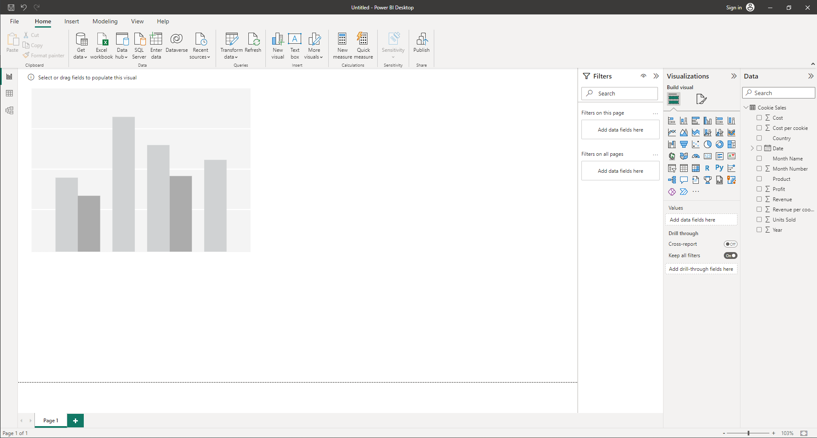
Click here to bring the element onto the report

Slide 20
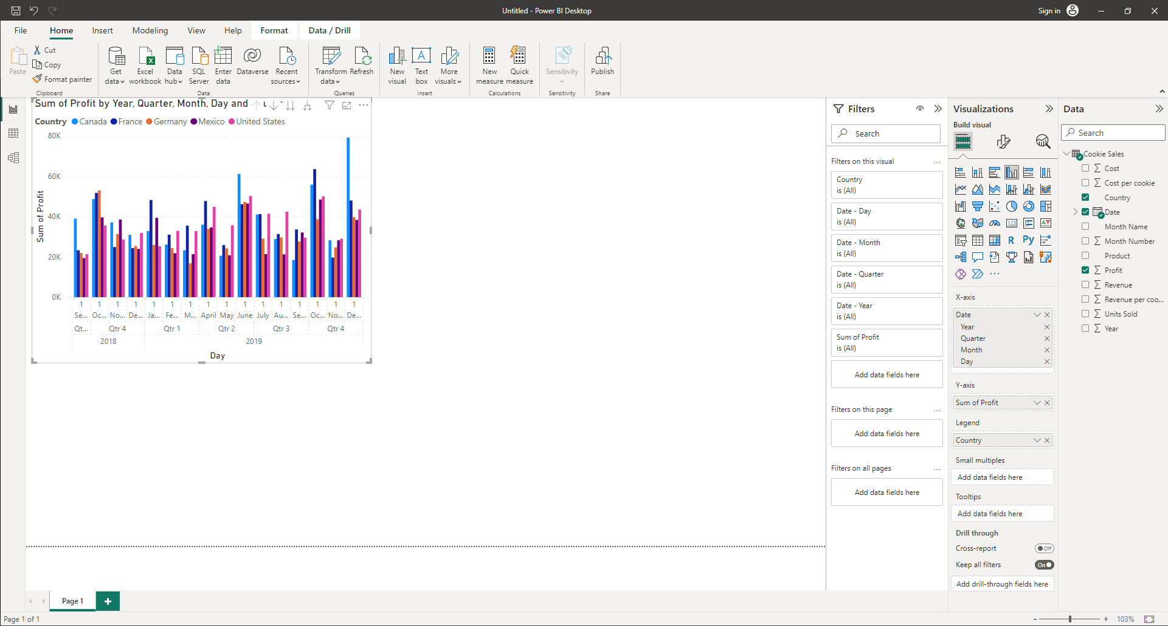
2
Drag these fields according to specifications
3
Remove Quarter and Day from the Date
1
Select the element

Slide 21
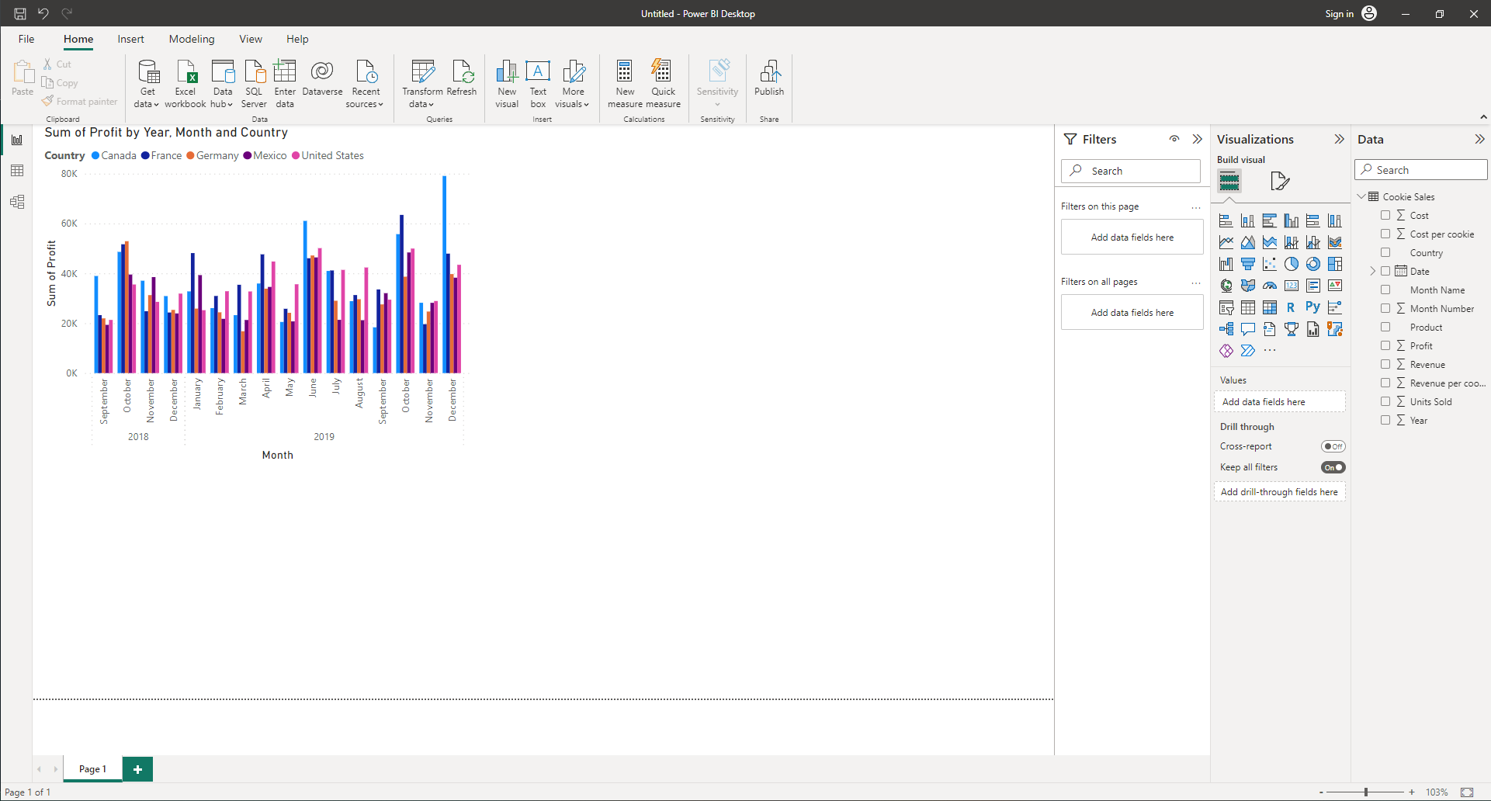
Your report should look something like this now

Slide 22
Let’s Add Some More Data

Slide 23
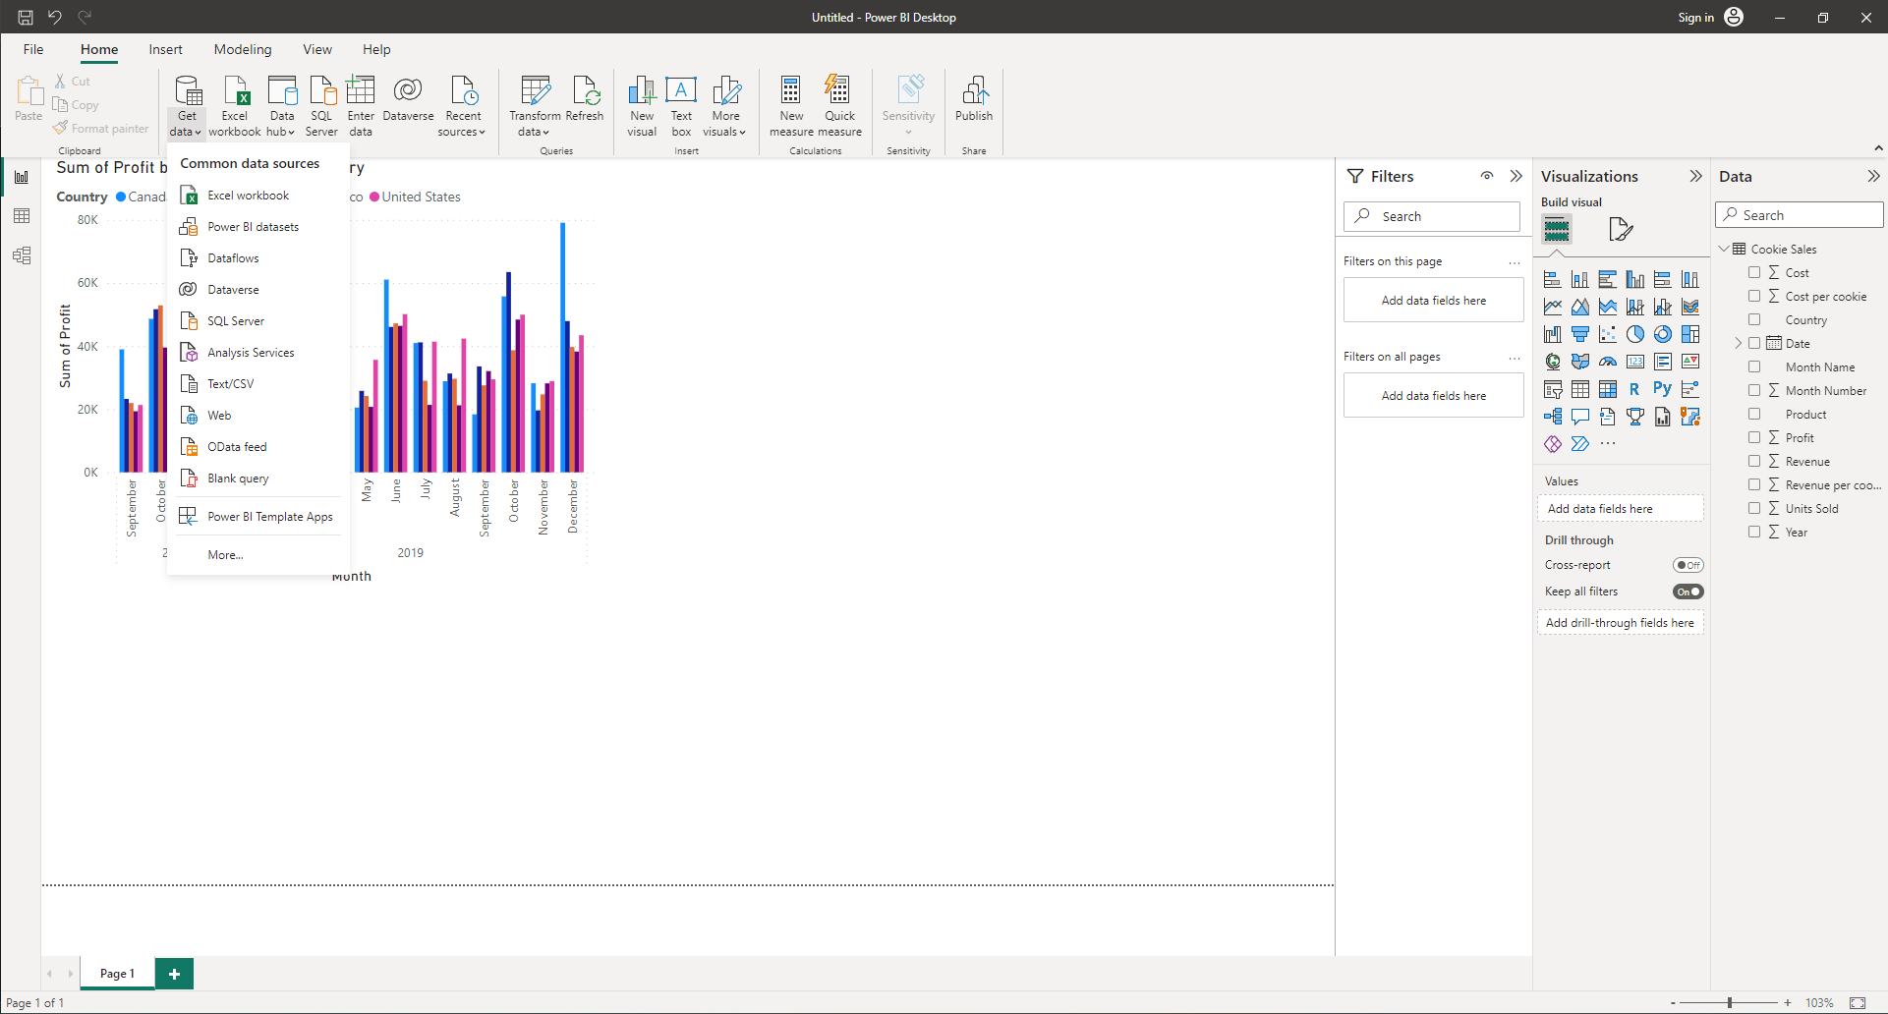
1
Click on Get Data
2
Click Web

Slide 24
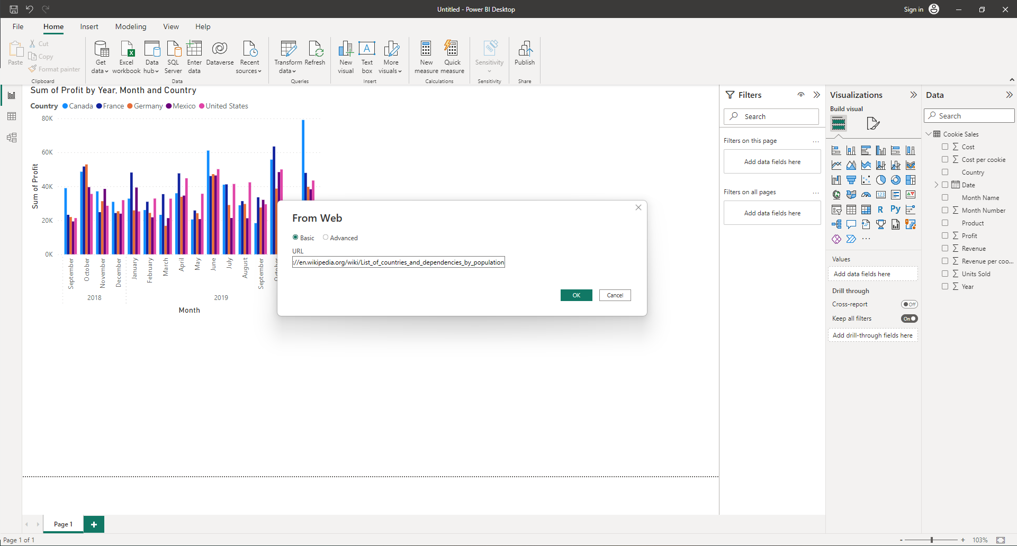
Paste this url: https://en.wikipedia.org/wiki/List_of_countries_and_dependencies_by_population
Then click OK

Slide 25
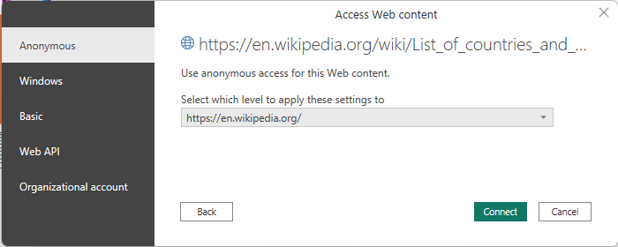
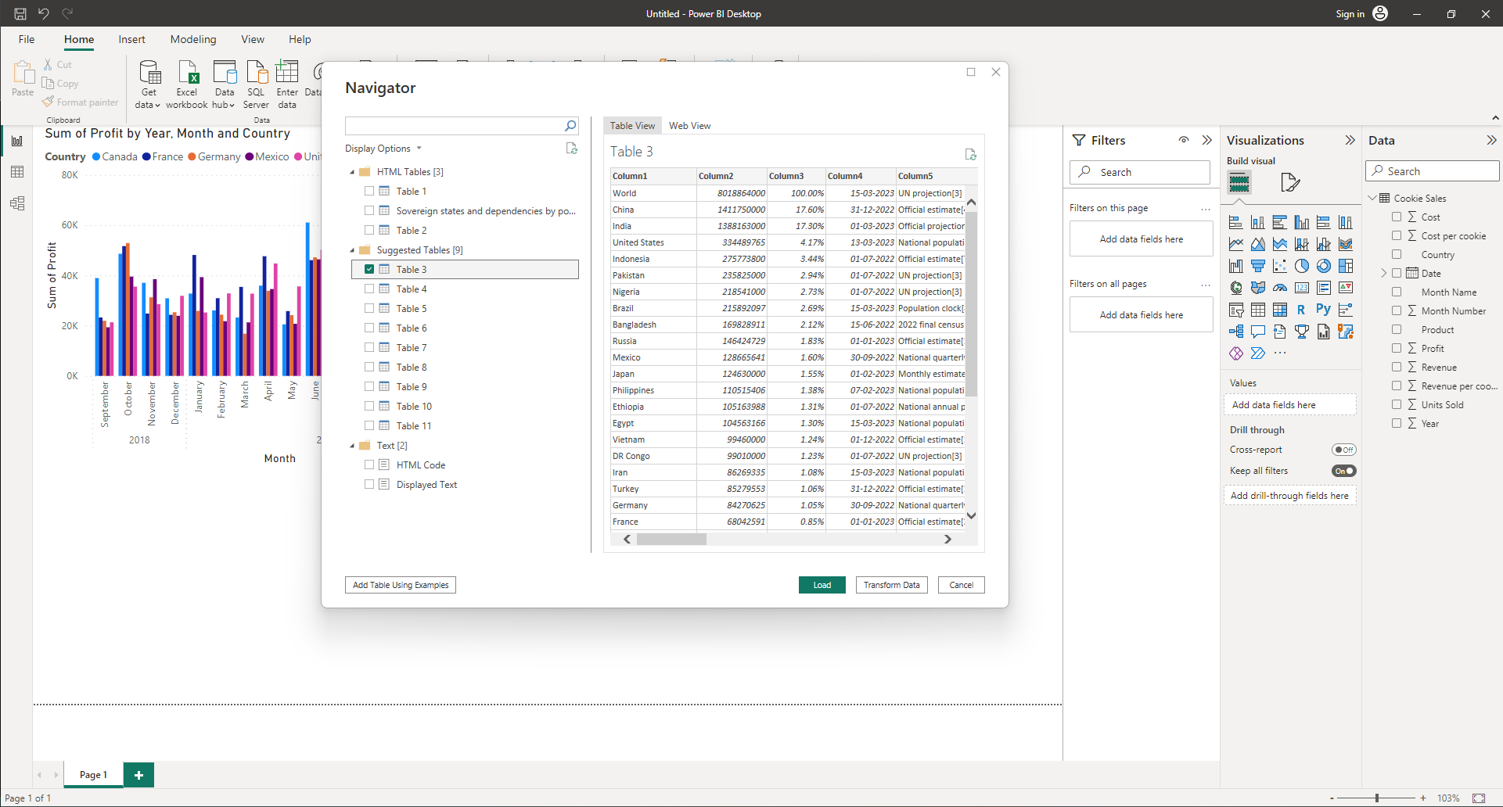
If this pops out, we can just click connect as Anonymous
Select the table which has Population information
Press Transform Data

Slide 26
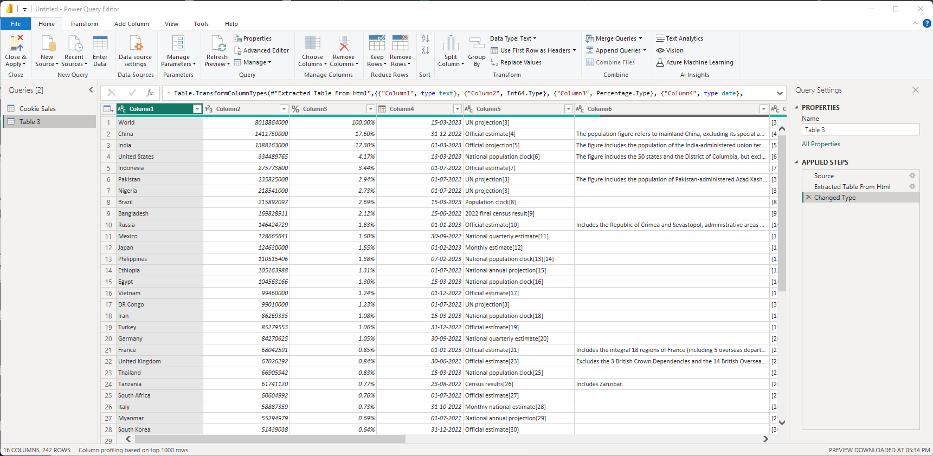
This is Power Query Editor

Slide 27
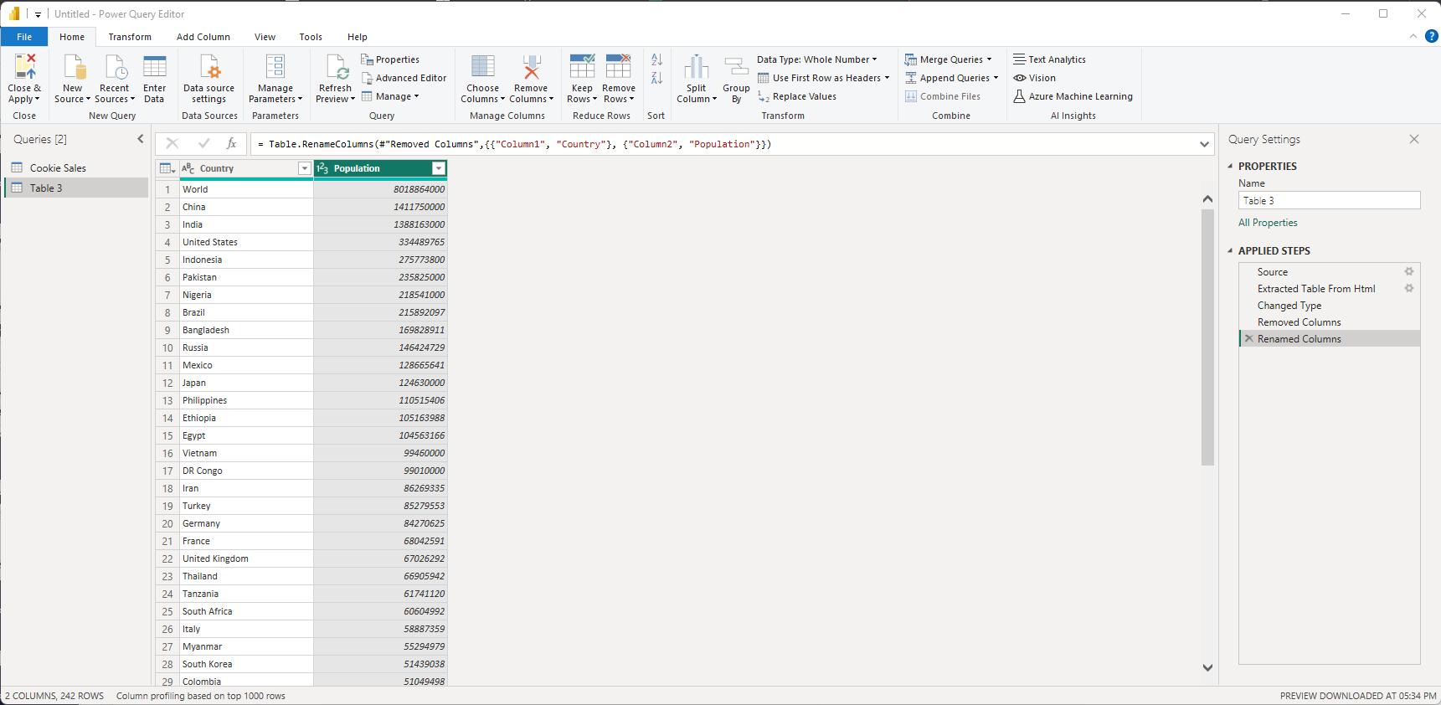
2
Once you’re done editing, press Close & Apply Button
1
Right click on the column headers and remove all columns except the first two, and rename them to Country and Population

Slide 28
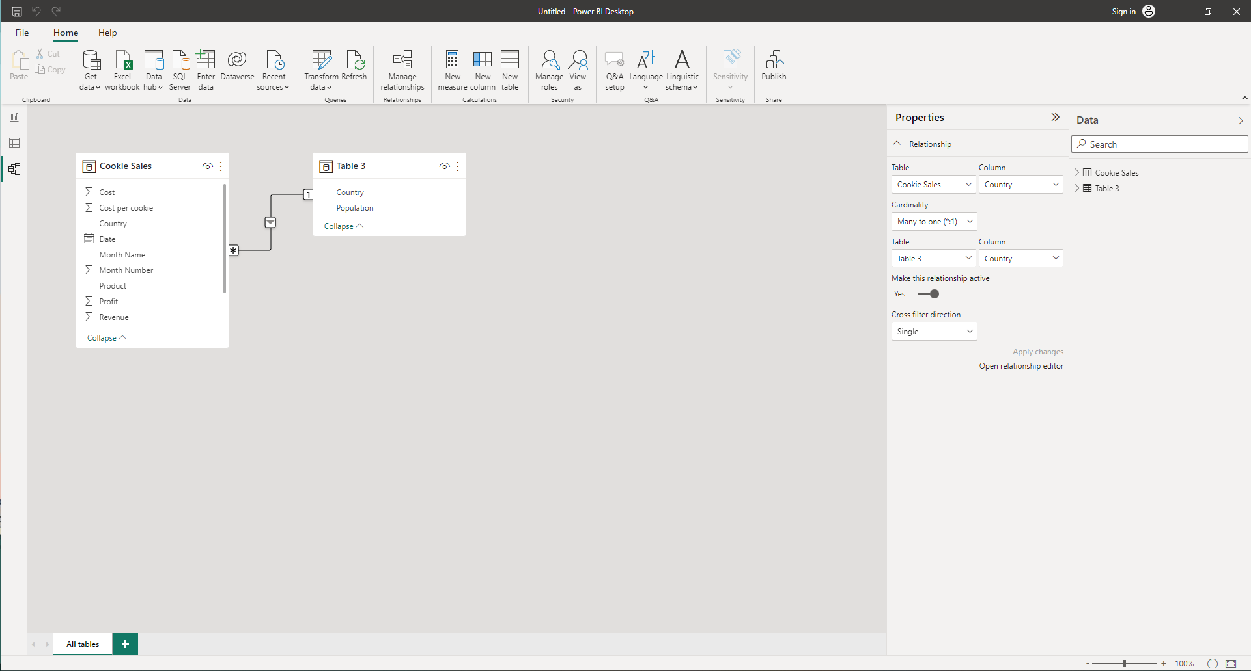
Click on the Relationship tab to see how the two tables are connected. And then switch back to Reports tab.

Slide 29
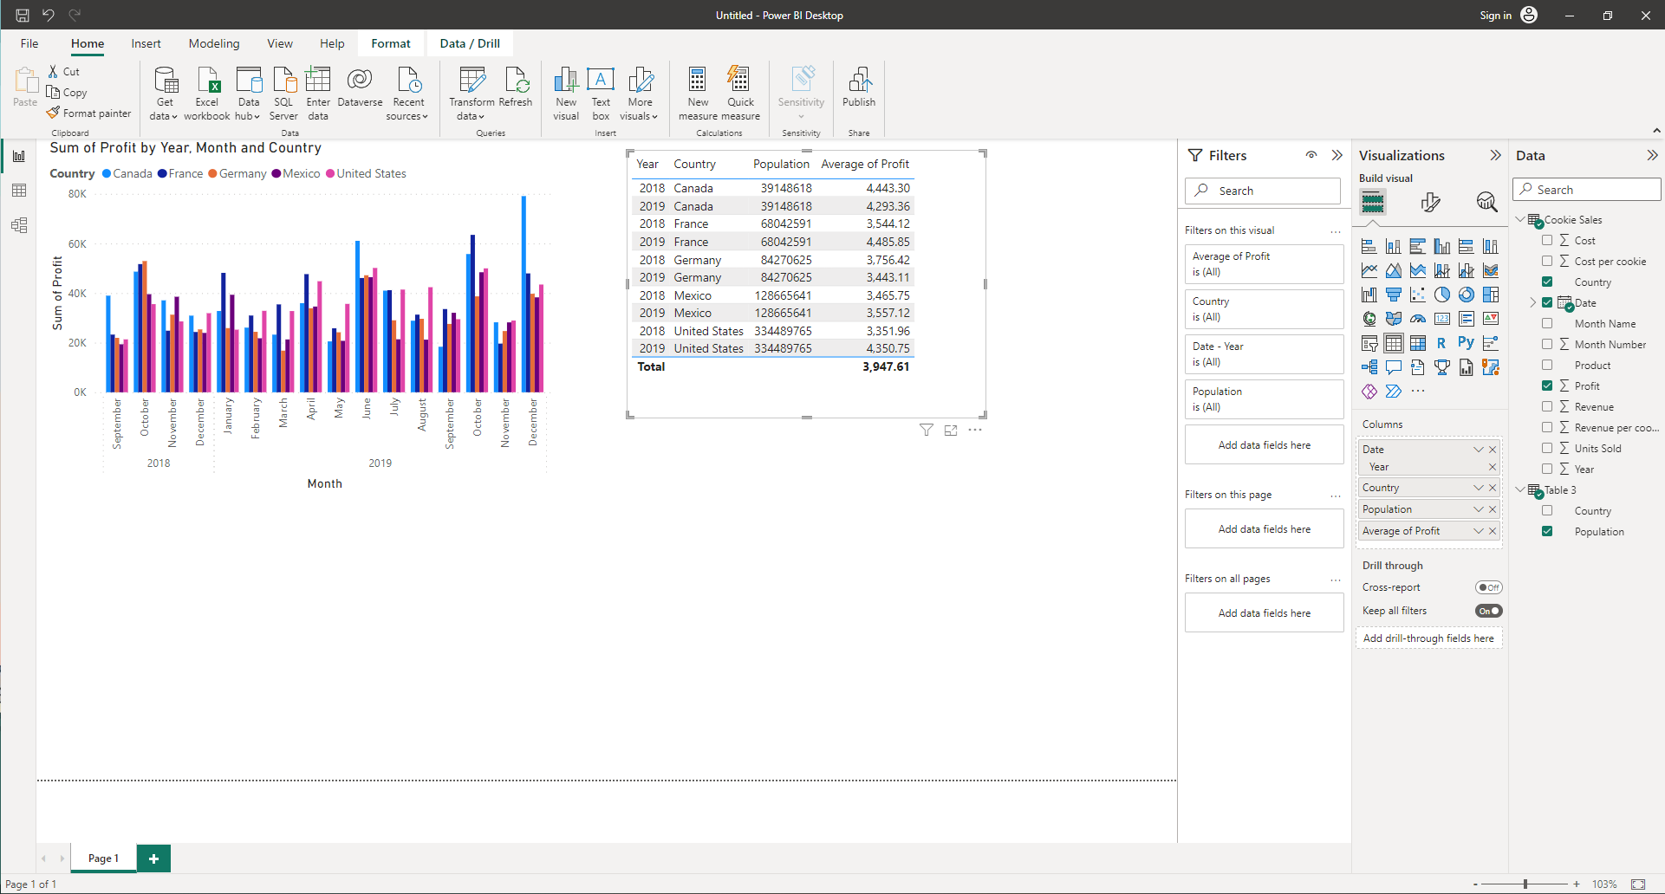
1
Now add a Table with the following specifications from both the datasets.
2
Click on ‘Format your Visuals’ Button

Slide 30
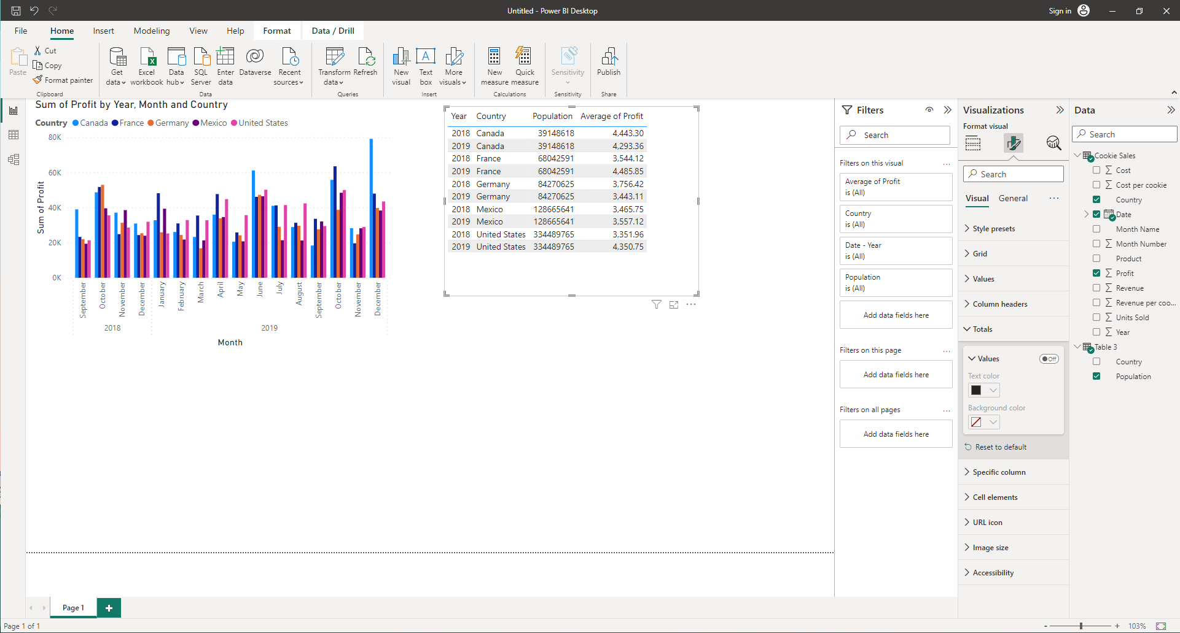
Turn the totals off

Slide 31
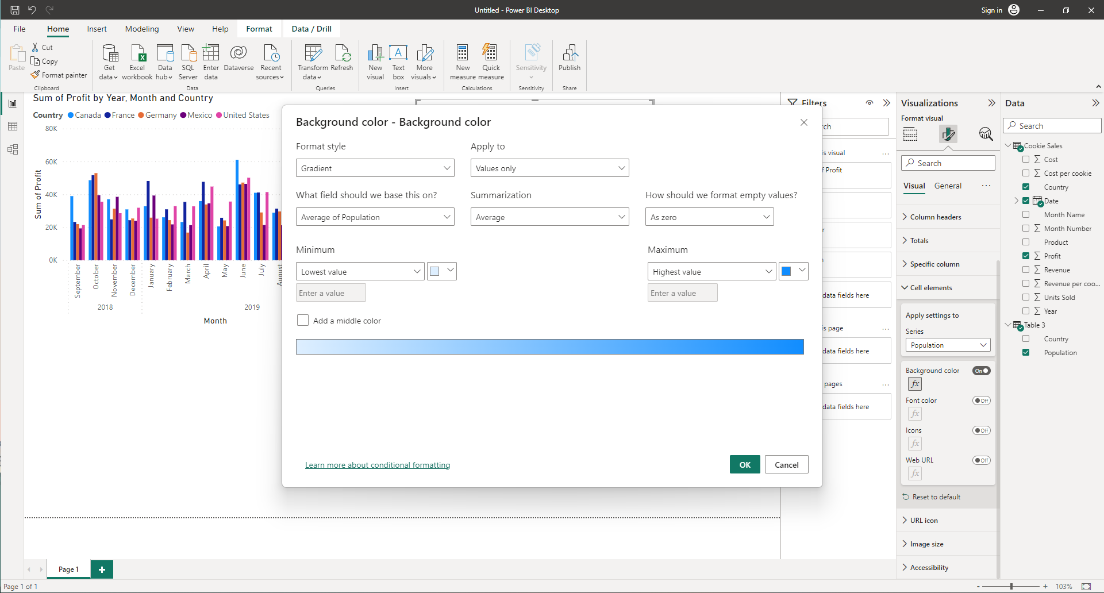
2
1
Go to Cell elements and select Population, then turn on Background
Change summarization to Average and click OK

Slide 32
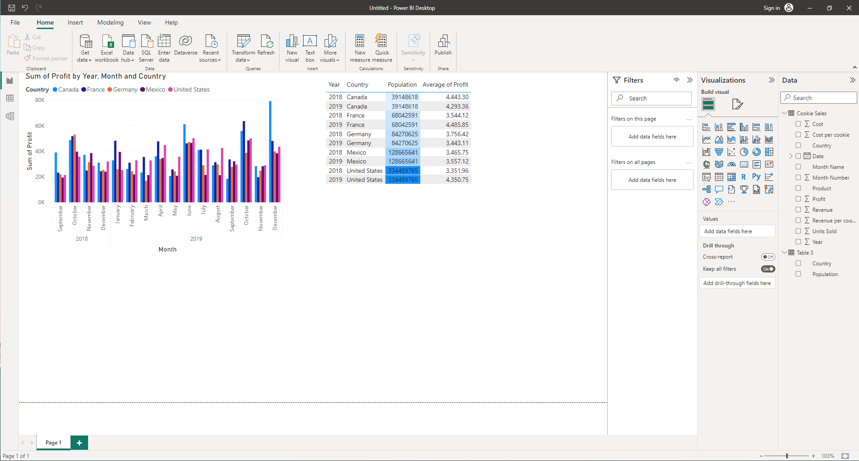
You should end up with a table looking like this.

Slide 33
Keep Adding more elements and exploring ways to format the Cells

